Slide 1
Travel Assistant Webapp
GROUP 2
Ayush Kumar Sahu 240738992
Bradley Aldous 140172636
Mehad Farooq 241031818
Sakshi Rahul Kothari 240814654
Guruprasad Bekkalale Rudresha 240368434

Slide 2
Introduction
Overview:
What is the Travel Assistant Webapp?
The Application is designed to provide users with essential information and tools for exploring and experiencing cities. Key features include real-time weather updates to help plan activities, user-generated reviews for valuable insights, and curated lists of popular restaurants and tourist attractions to showcase the best the city has to offer. Additionally, the application supports user account creation and management, ensuring a personalized and engaging experience. This project aims to simplify city exploration, making it a go-to platform for travelers and locals alike.

Slide 3
Key Features
Displays the weather for the requested city
Displays user reviews for the requested city, and allows users to submit new reviews
Displays popular restaurants for the requested city
Displays popular tourist attractions for the requested city
Allows user access and management

Slide 4
FLASK
Flask is a lightweight and flexible web framework for Python that allows developers to build web applications quickly and easily. It is part of the micro-framework category, meaning it provides the essential tools needed for web development but doesn't enforce specific tools or libraries, giving developers the freedom to choose.

Slide 5
FIREBASE
Firebase is a cloud-based platform developed by Google that provides a suite of tools and services for building and managing web and mobile applications. It simplifies backend development, offering ready-to-use features.

Slide 6
API
An API (Application Programming Interface) is a set of rules and protocols that allows different software applications to communicate with each other. It acts as an intermediary, enabling one application to request data or services from another without needing to understand how the other application is implemented.

Slide 7
OPEN WEATHER MAP API
OpenWeather API is a versatile tool for accessing real-time weather data, and forecasts. It provides features such as current weather updates, daily forecasts, andair pollution data. With its global coverage of over 200,000 cities and easy integration through simple HTTP requests. It is scalable, user-friendly, and supports diverse use cases with its extensive data offerings.

Slide 8
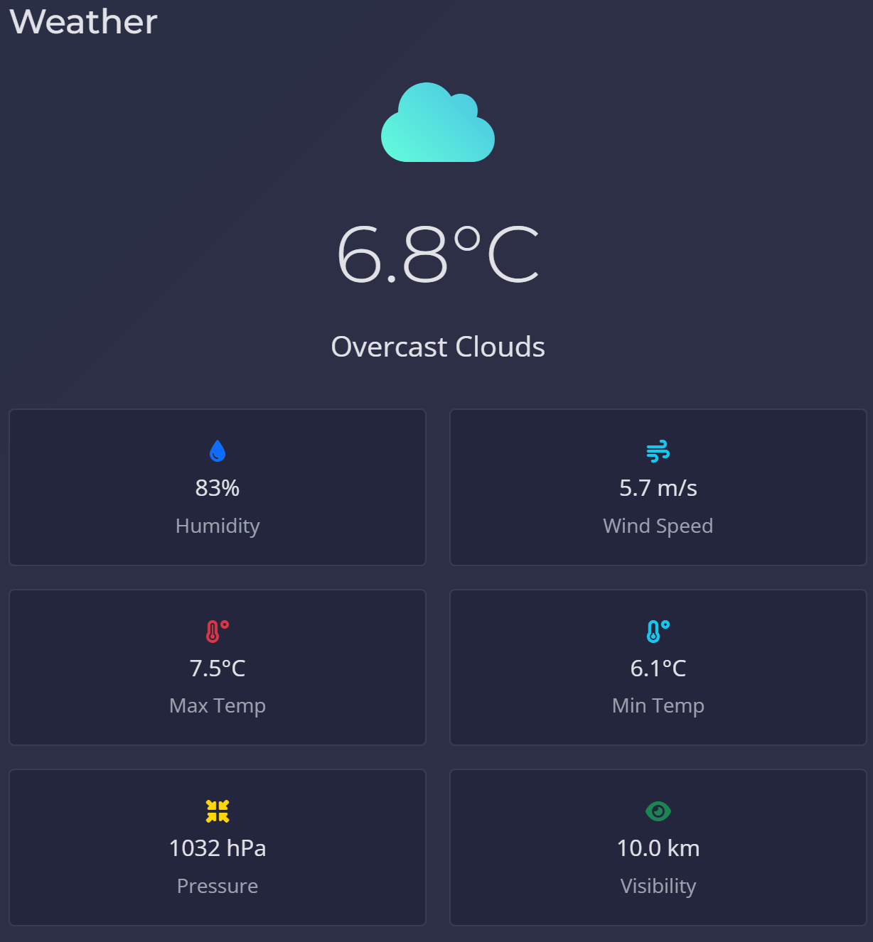

Slide 9
GEOPIFY
Geopify is a location-based API platform that provides geocoding and mapping services to developers. It enables the integration of geographic data and location intelligence into applications. Geopify is particularly useful in applications like travel apps, logistics, real estate platforms, and any service requiring location-based functionality.

Slide 10
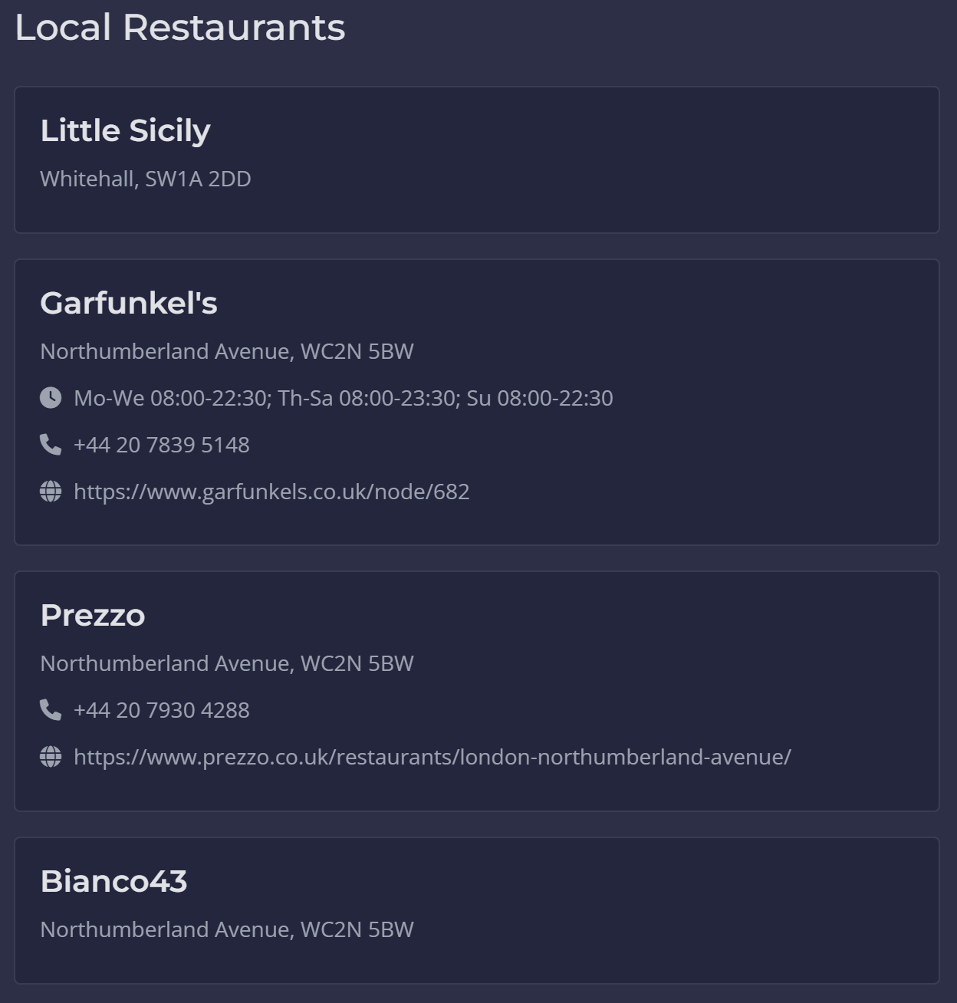
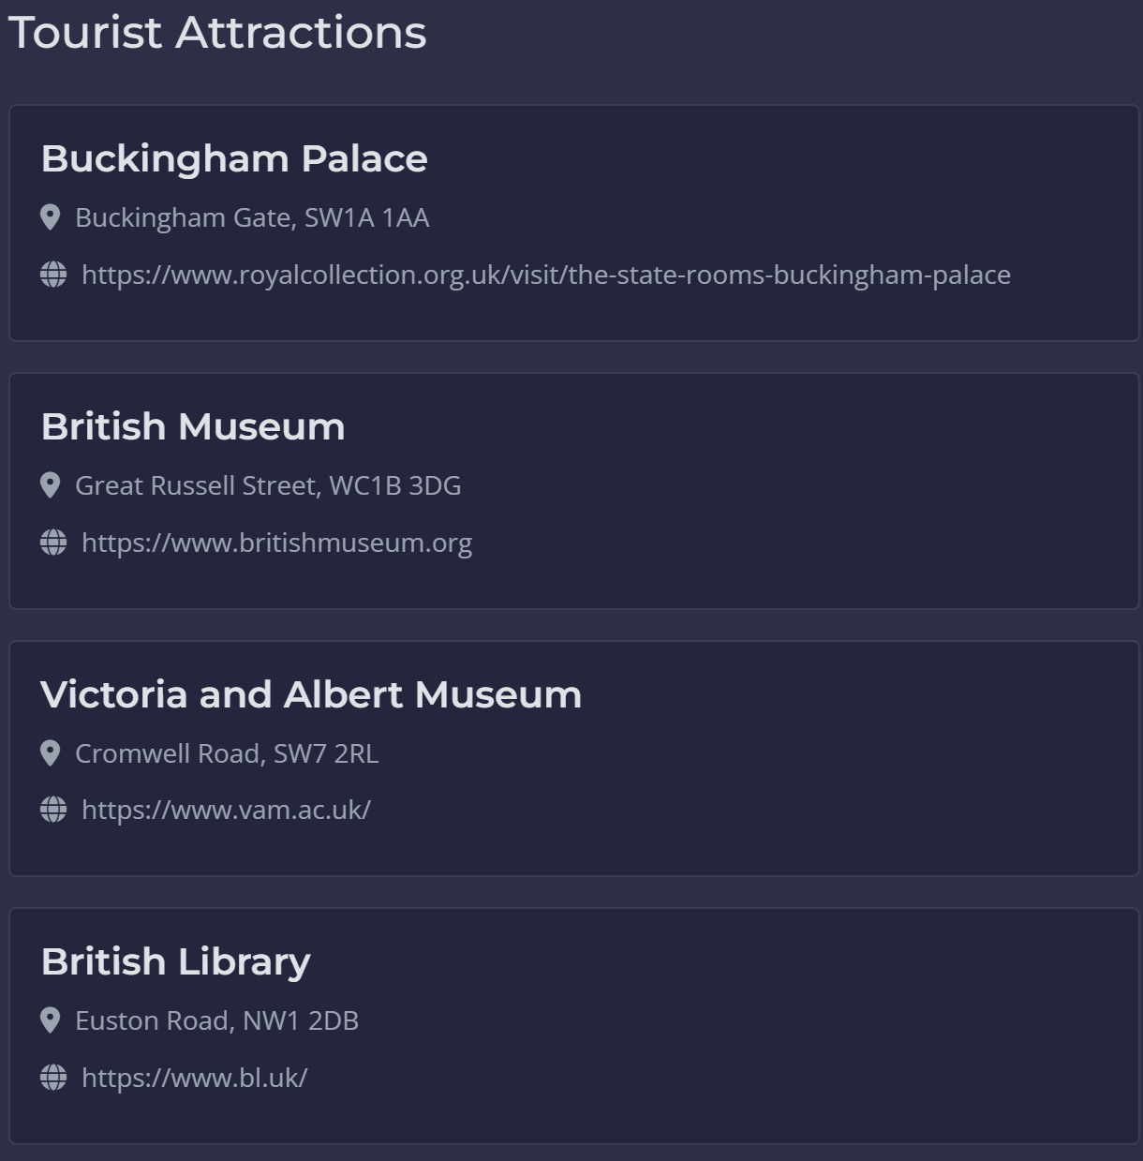

Slide 11
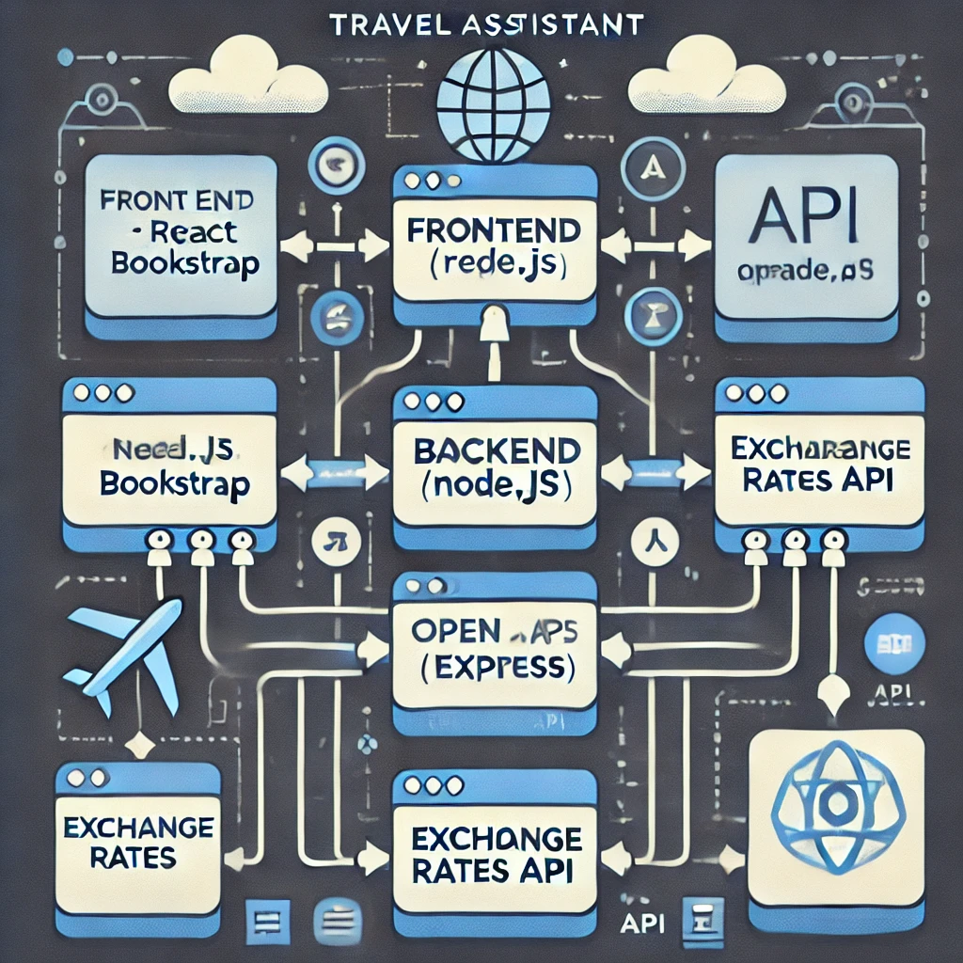
Workflow Diagram
1. User Interaction:
Registration/Login
2. Core Functions:
- Trip creation and storage
- Data retrieval for recommendations
3. Third-Party Integration:
APIs like Google Maps for enhanced functionality

Slide 12
Benefits
For Users
Simplifies trip planning and organization.
Offers tailored travel insights.
Provides a unified platform for multiple travel-related tasks.

Slide 13
Challenges and Solutions
CHALLENGES
- API rate limitations.
- Database optimization for large user bases.
- Ensuring mobile responsiveness.
SOLUTIONS
- Improved caching mechanisms.
- Regular performance testing.
- Implementation of responsive frameworks like Bootstrap

Slide 14
Future Enhancements
1. Social Media Integration
- Share itineraries and travel plans.
2. AI-Powered Recommendations
- Enhance personalization with machine learning.
3. Offline Mode
- Access itinerary and navigation without internet

Slide 15
Conclusion
The Travel Assistant Web App simplifies travel planning by combining advanced features with a user-friendly interface. It is a practical tool for both casual and frequent travelers.

